Slide 1

Trigonometric Substitution
Copyright © Cengage Learning. All rights reserved.

Slide 2
Objectives
Use trigonometric substitution to solve an integral.
Use integrals to model and solve real-life applications.

Slide 3
Trigonometric Substitution

Slide 4
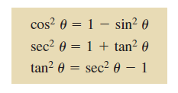
Trigonometric Substitution
You can ise trigonometric substitution to evaluate integrals involving the radicals
The objective with trigonometric substitution is to eliminate the radical in the integrand. You do this by using the Pythagorean identities

Slide 5
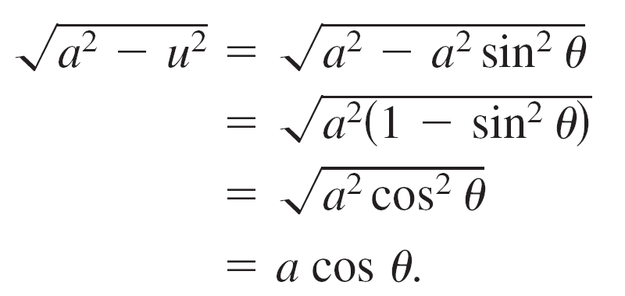
Trigonometric Substitution
For example, for a > 0, let u = asin θ, where –π/2 ≤ θ ≤ π/2.
Then
Note that cos θ ≥ 0, because –π/2 ≤ θ ≤ π/2.

Slide 6
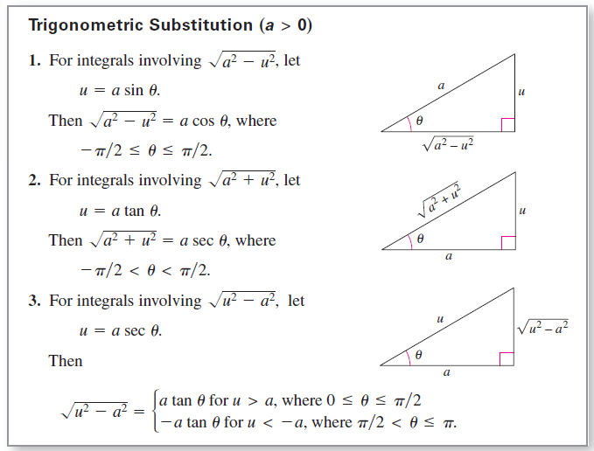
Trigonometric Substitution

Slide 7
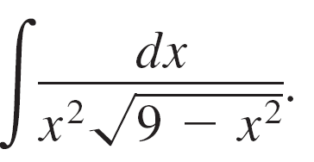


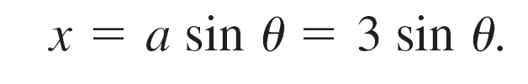
Example 1 – Trigonometric Substitution: u = asin θ
Find
Solution:
First, note that none of the basic integration rules applies.
To use trigonometric substitution, you should observe that
is of the form
So, you can use the substitution

Slide 8
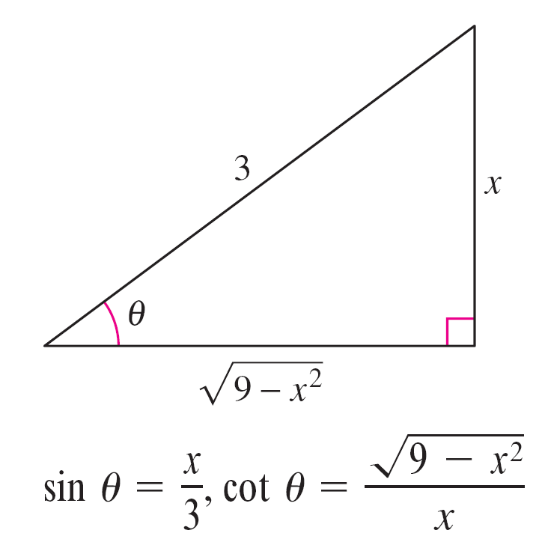
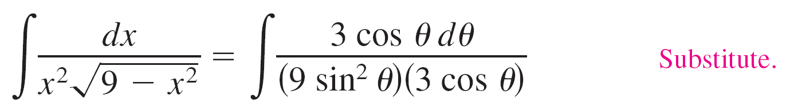
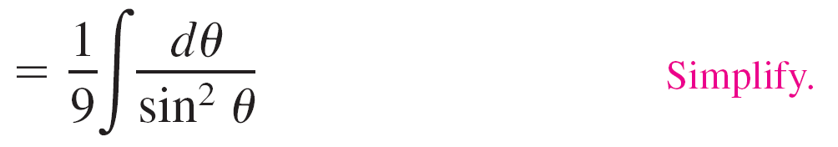
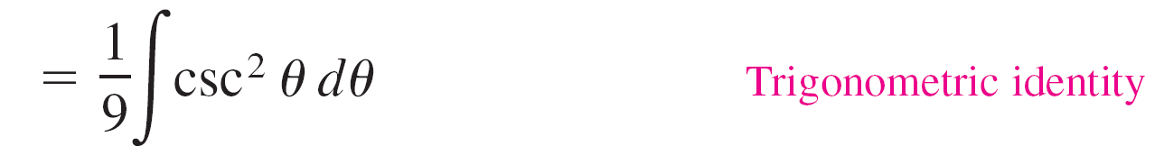
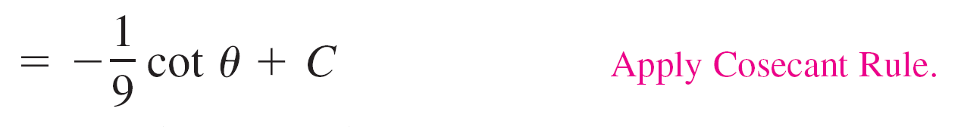
Example 1 – Solution
cont’d
Using differentiation and the triangle shown in Figure 8.6, you obtain
So, trigonometric substitution yields
Figure 8.6

Slide 9
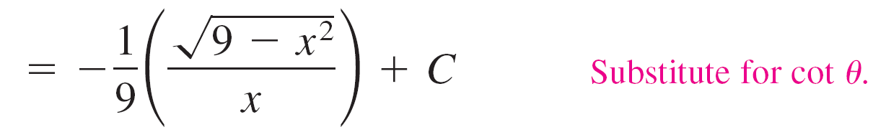
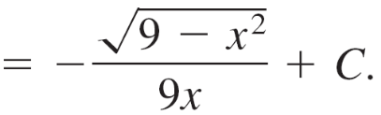
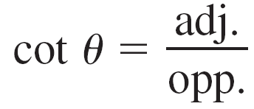
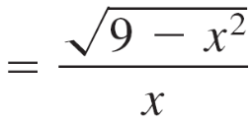
Example 1 – Solution
cont’d
Note that the triangle in Figure 8.6 can be used to convert the θ ’s back to x’s, as follows.

Slide 10
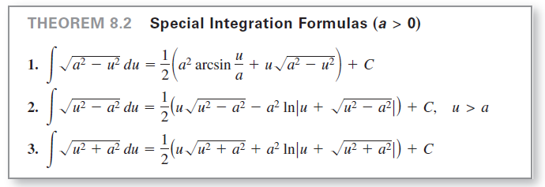
Trigonometric Substitution
Trigonometric substitution can be used to evaluate the three integrals listed in the next theorem. These integrals will be encountered several times.

Slide 11
Applications

Slide 12

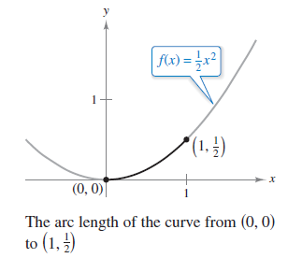
Example 5 – Finding Arc Length
Find the arc length of the graph of from
x = 0 to x = 1 (see Figure 8.10).
Figure 8.10

Slide 13
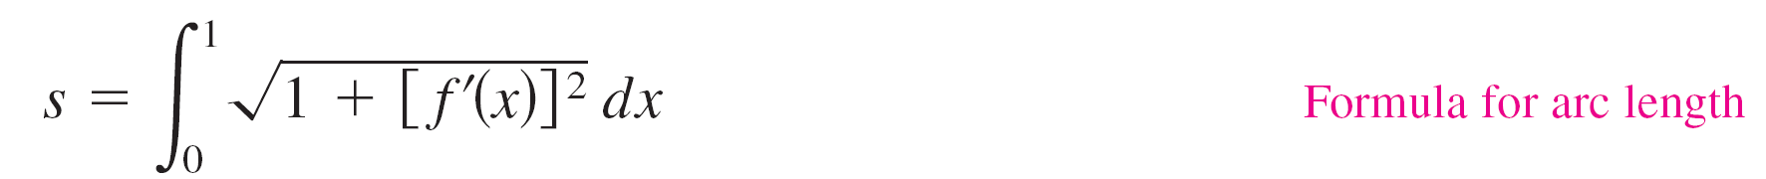
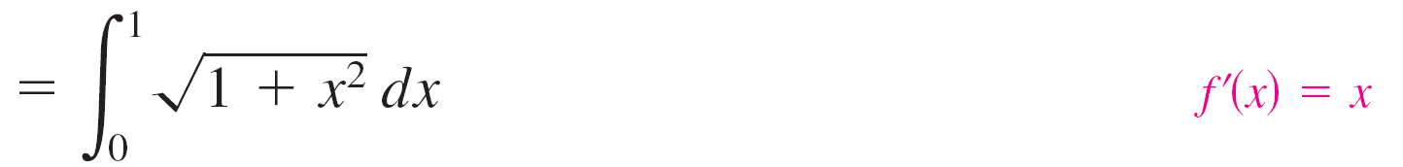

Example 5 – Solution
Refer to the arc length formula.

